Slide 1

Application Delivery Fundamentals
Parameswari Ettiappan

Slide 2
Goals
BPMN
DMN Training
BPM & Process Automation
Process Engine
Process Applications
Camunda BPM and Microservices
Tools & Infrastructure
Camunda BPM Docker / Open shift Deployment

Slide 3
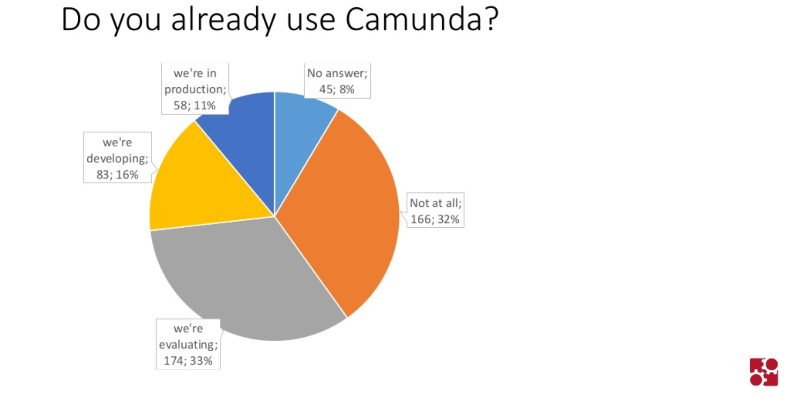

Slide 4
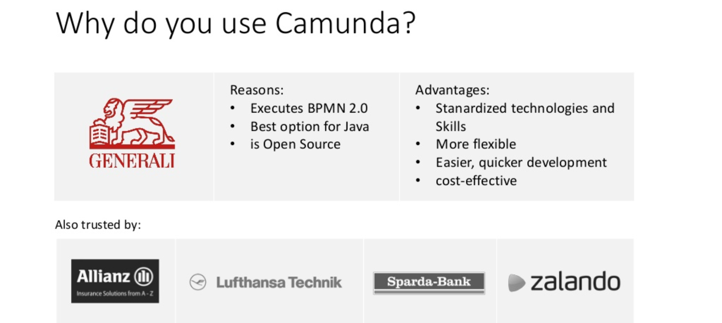

Slide 5
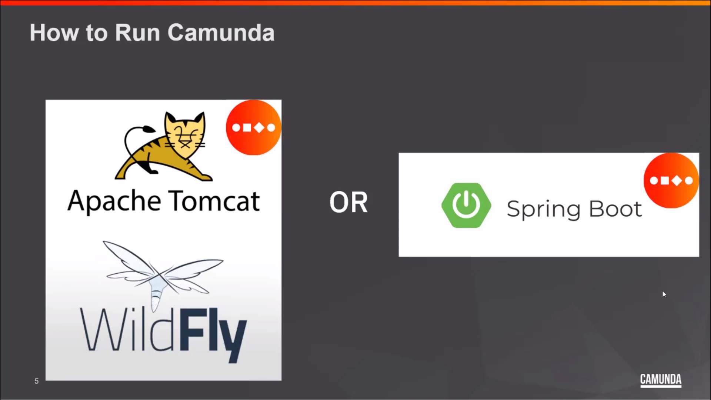
Camunda

Slide 6
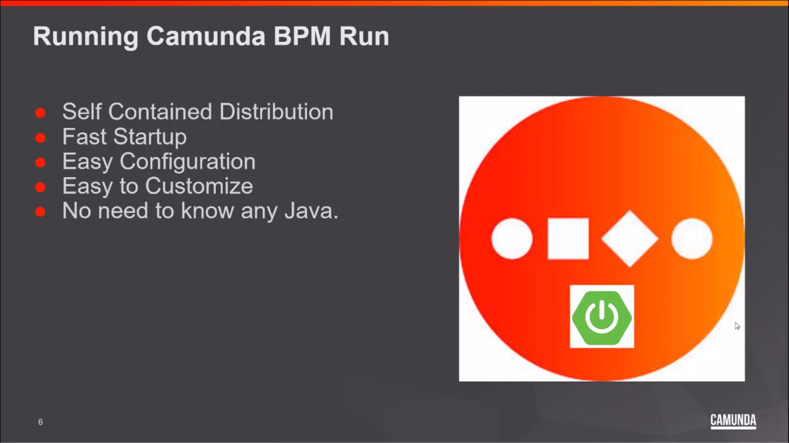
Camunda

Slide 7
Camunda BPM Run

Slide 8
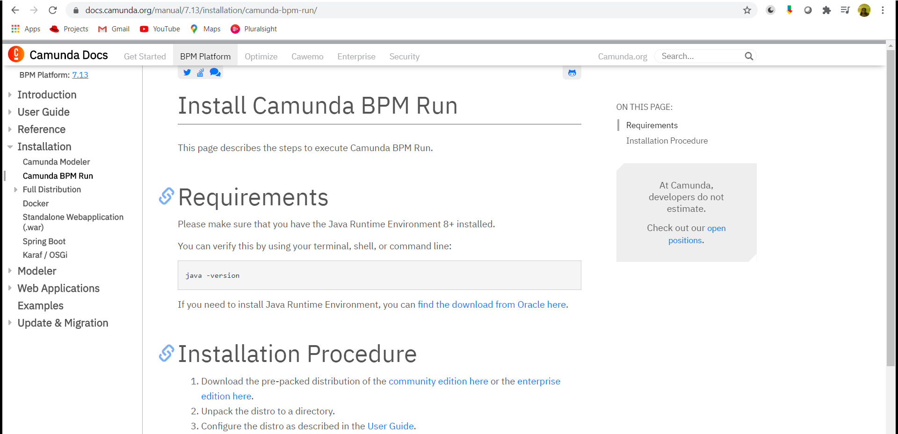
Camunda Installation

Slide 9
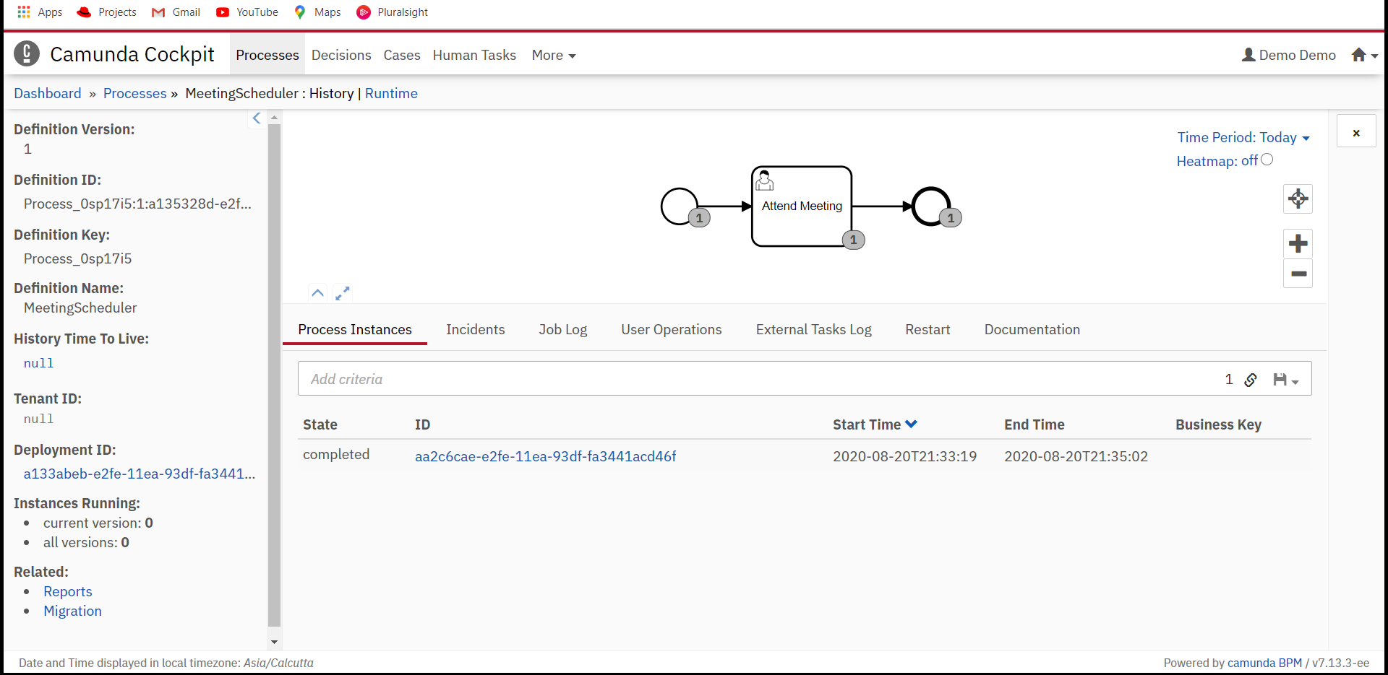
Camunda Installation

Slide 10

https://start.camunda.com/

Slide 11
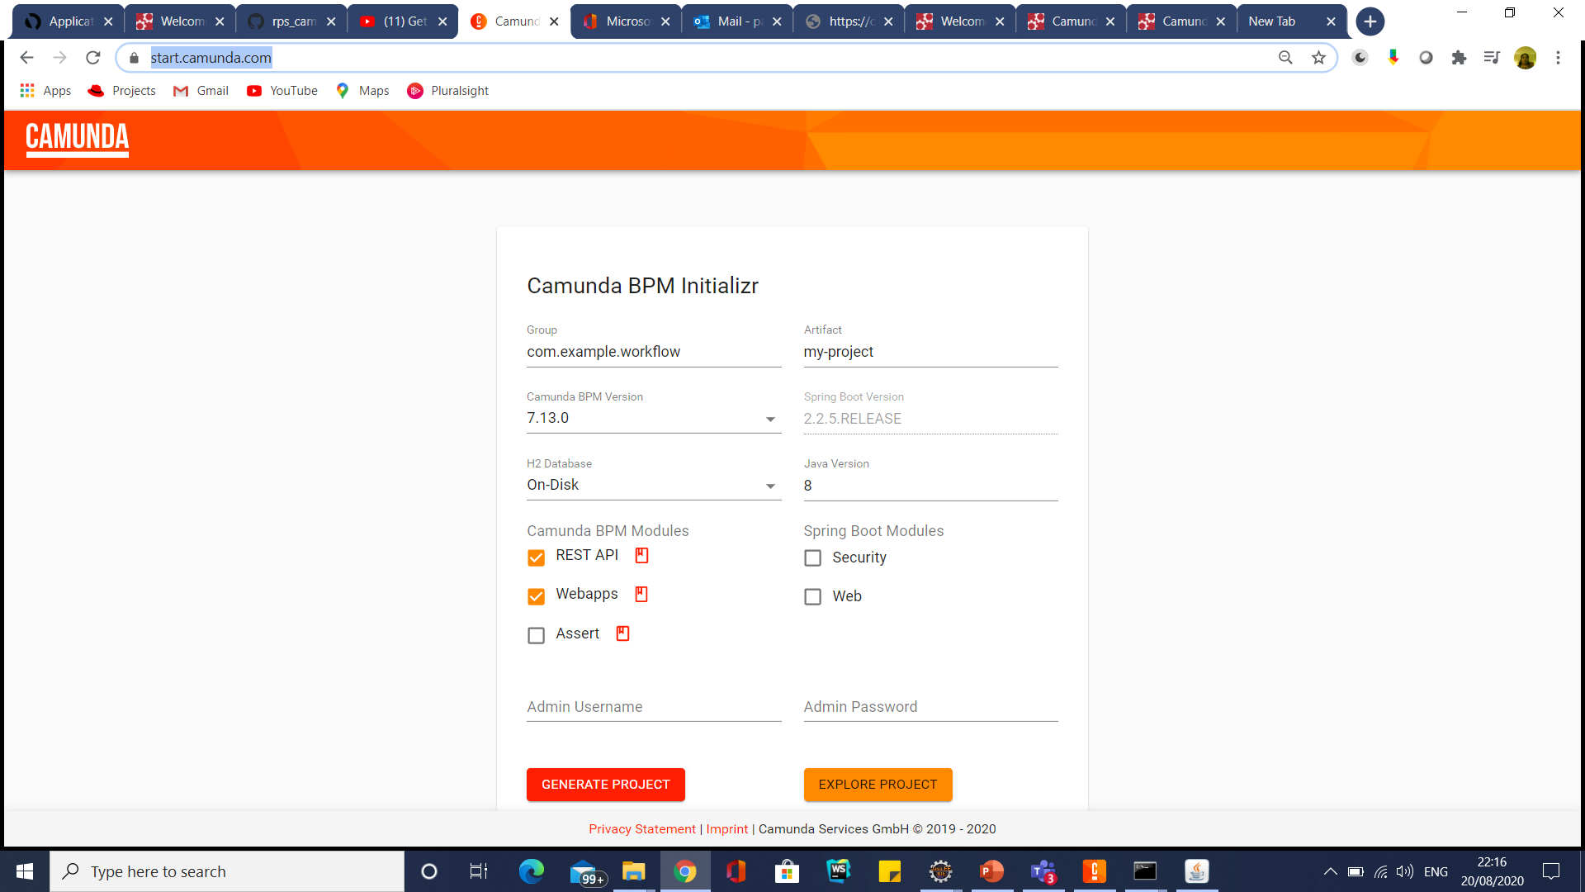
Spring Boot Integration

Slide 12
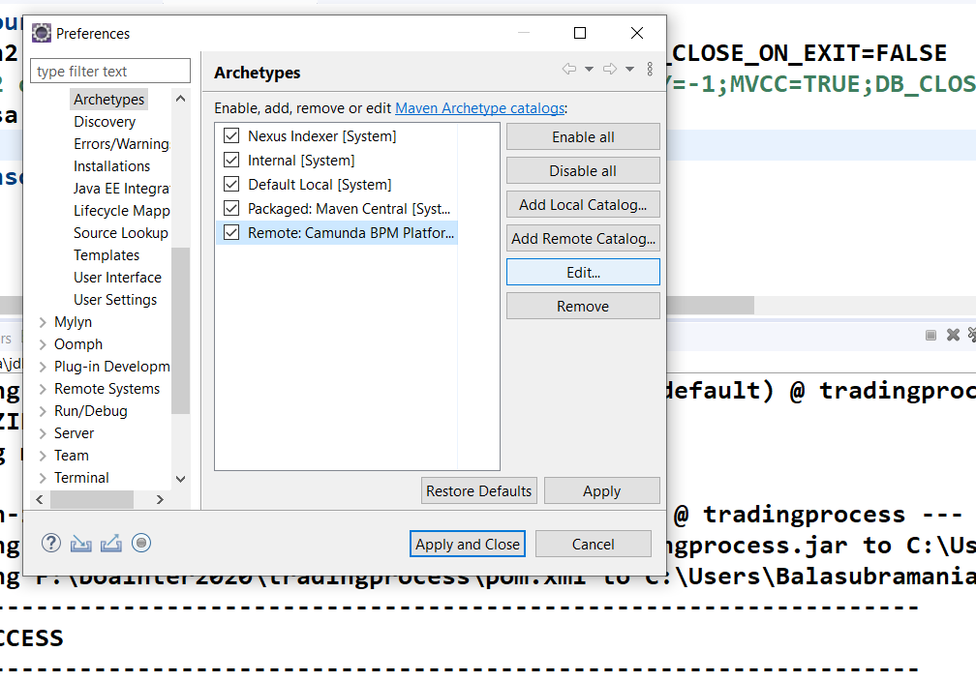
Usage in Eclipse IDE

Slide 13
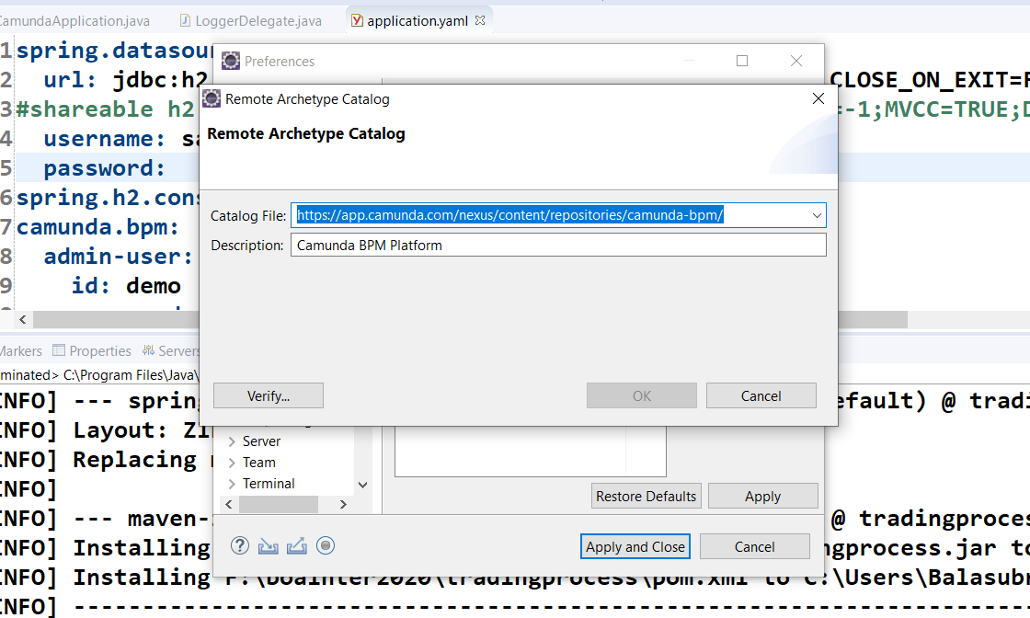
Usage in Eclipse IDE
https://app.camunda.com/nexus/content/repositories/camunda-bpm/

Slide 14
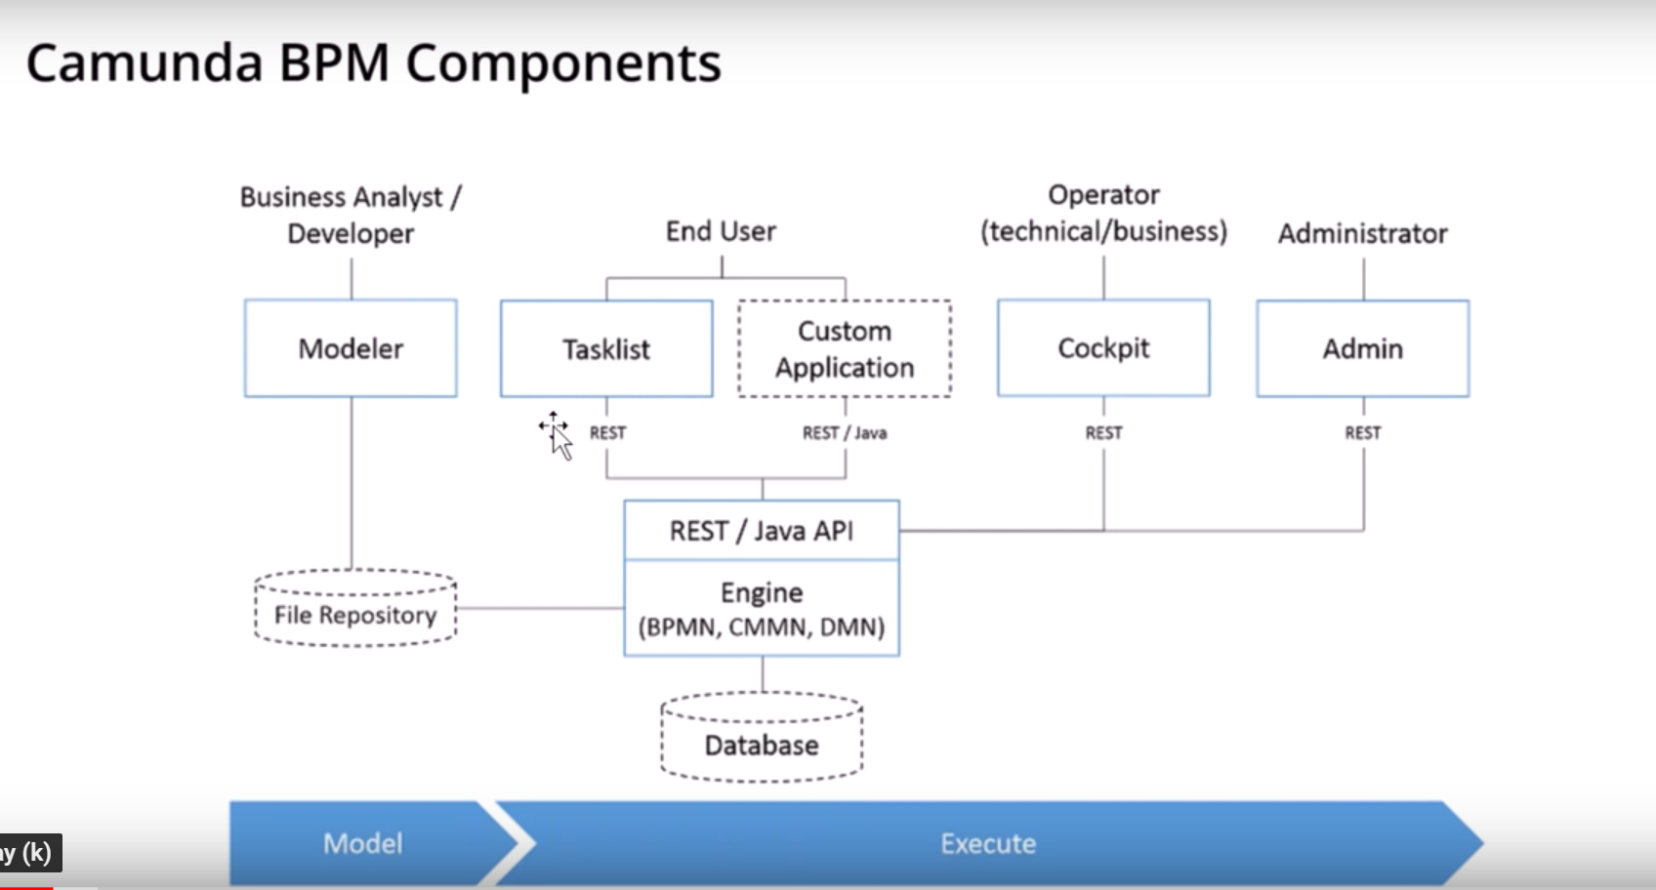

Slide 15
Architecture
Camunda BPM is a Java-based framework.
The main components are written in Java.
It has focus on providing Java developers with the tools they need for designing, implementing and running business processes and workflows on the JVM.
It provides process engine technology available to non-Java developers.
This is why Camunda BPM also provides a REST API which is used to build applications connecting to a remote process engine.

Slide 16
Architecture
Camunda BPM can be used both as a standalone process engine server or embedded inside custom Java applications.

Slide 17
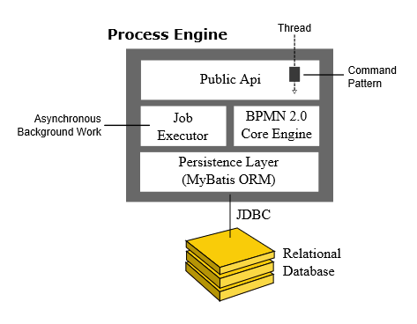
Process Engine Architecture

Slide 18
BPMN 2.0
BPMN 2.0 Core Engine: This is the core of the process engine.
It features a lightweight execution engine for graph structures (PVM - Process Virtual Machine).
A BPMN 2.0 parser which transforms BPMN 2.0 XML files into Java Objects and a set of BPMN Behavior implementations.

Slide 19
Process Engine Public API
Process Engine Public API: Service-oriented API allowing Java applications to interact with the process engine.
The different responsibilities of the process engine (i.e., Process Repository, Runtime Process Interaction, Task Management, …) are separated into individual services.
The public API features a command-style access pattern:
Threads entering the process engine are routed through a Command Interceptor which is used for setting up Thread Context such as Transactions.

Slide 20
Job Executor
Job Executor: The Job Executor is responsible for processing asynchronous background work such as Timers or asynchronous continuations in a process.
The Persistence Layer: The process engine features a persistence layer responsible for persisting process instance state to a relational database.
It uses MyBatis mapping engine for object relational mapping.

Slide 21
Camunda BPM Platform Architecture
Camunda BPM platform is a flexible framework which can be deployed in different scenarios.
Embedded Process Engine
Shared, Container-Managed Process Engine
Standalone (Remote) Process Engine Server
Clustering Model

Slide 22
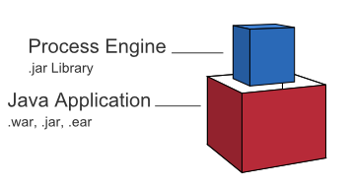
Embedded Process Engine
The process engine is added as an application library to a custom application.
This way, the process engine can easily be started and stopped with the application lifecycle.
It is possible to run multiple embedded process engines on top of a shared database.

Slide 23
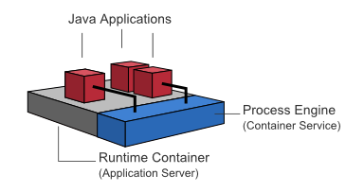
Shared, Container-Managed Process Engine
In this case, the process engine is started inside the runtime container (Servlet Container, Application Server, …).
The process engine is provided as a container service and can be shared by all applications deployed inside the container.
The process engine keeps track of the process definitions deployed by an application and delegates execution to the application.

Slide 24
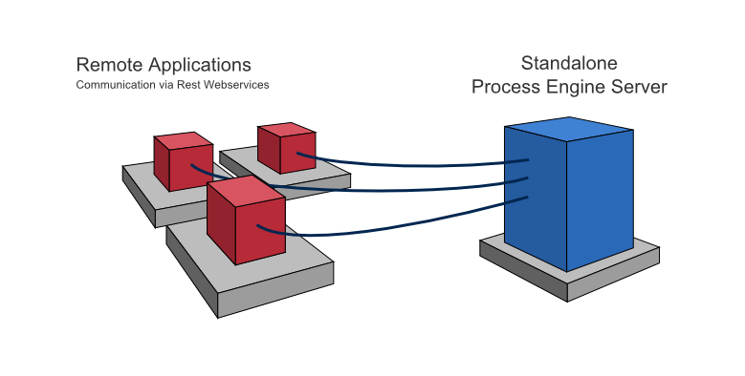
Standalone (Remote) Process Engine Server
The process engine is provided as a network service.
Different applications running on the network can interact with the process engine through a remote communication channel.
The easiest way to make the process engine accessible remotely is to use the built-in REST API.
Different communication channels such as SOAP Web services or JMS are possible but need to be implemented by users.

Slide 25
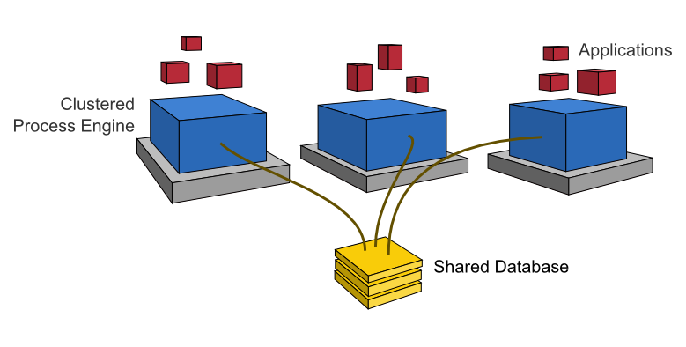
Clustering Model
In order to provide scale-up or fail-over capabilities, the process engine can be distributed to different nodes in a cluster.
Each process engine instance must then connect to a shared database.

Slide 26
Clustering Model
The individual process engine instances do not maintain session state across transactions.
Whenever the process engine runs a transaction, the complete state is flushed out to the shared database.
This makes it possible to route subsequent requests which do work in the same process instance to different cluster nodes.
As far as the process engine is concerned, there is no difference between setups for scale-up and setups for fail-over (as the process engine keeps no session state between transactions).

Slide 27
Session State in a Clustered Environment
Camunda BPM doesn’t provide load-balancing capabilities or session replication capabilities out of the box.
The load-balancing function would need to be provided by a third-party system.
Session replication would need to be provided by the host application server.

Slide 28
Session State in a Clustered Environment
“Sticky sessions” could be configured and enabled within your load balancing solution.
This would ensure that all requests from a given user are directed to the same instance over a configurable period of time.
Session sharing can be enabled in your application server such that the application server instances share session state.
This would allow users to connect to multiple instances in the cluster without being asked to login multiple times.

Slide 29
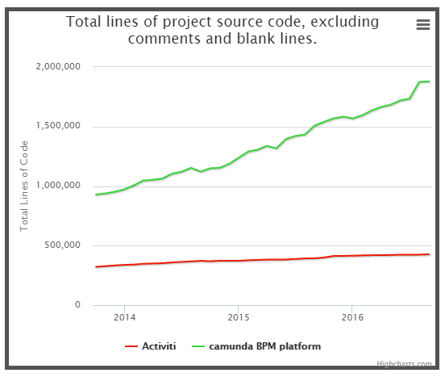

Slide 30
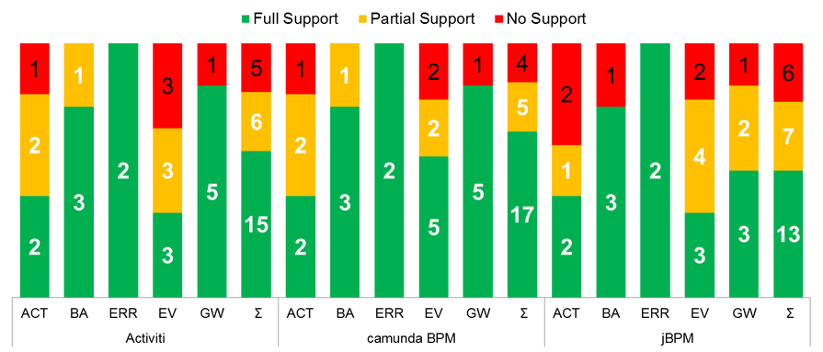
ACT stands for actitivities (task, subprocesses, …), BA for basics (sequenceFlows, lanes, participants, …), ERR for errors

Slide 31
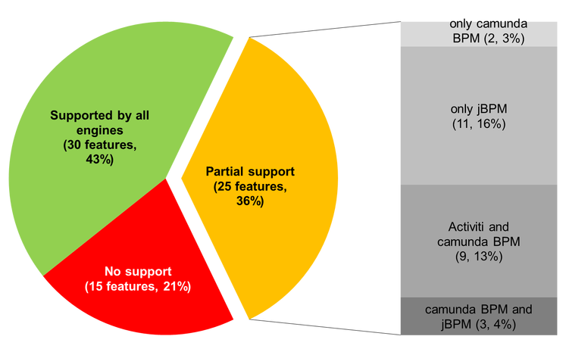

Slide 32
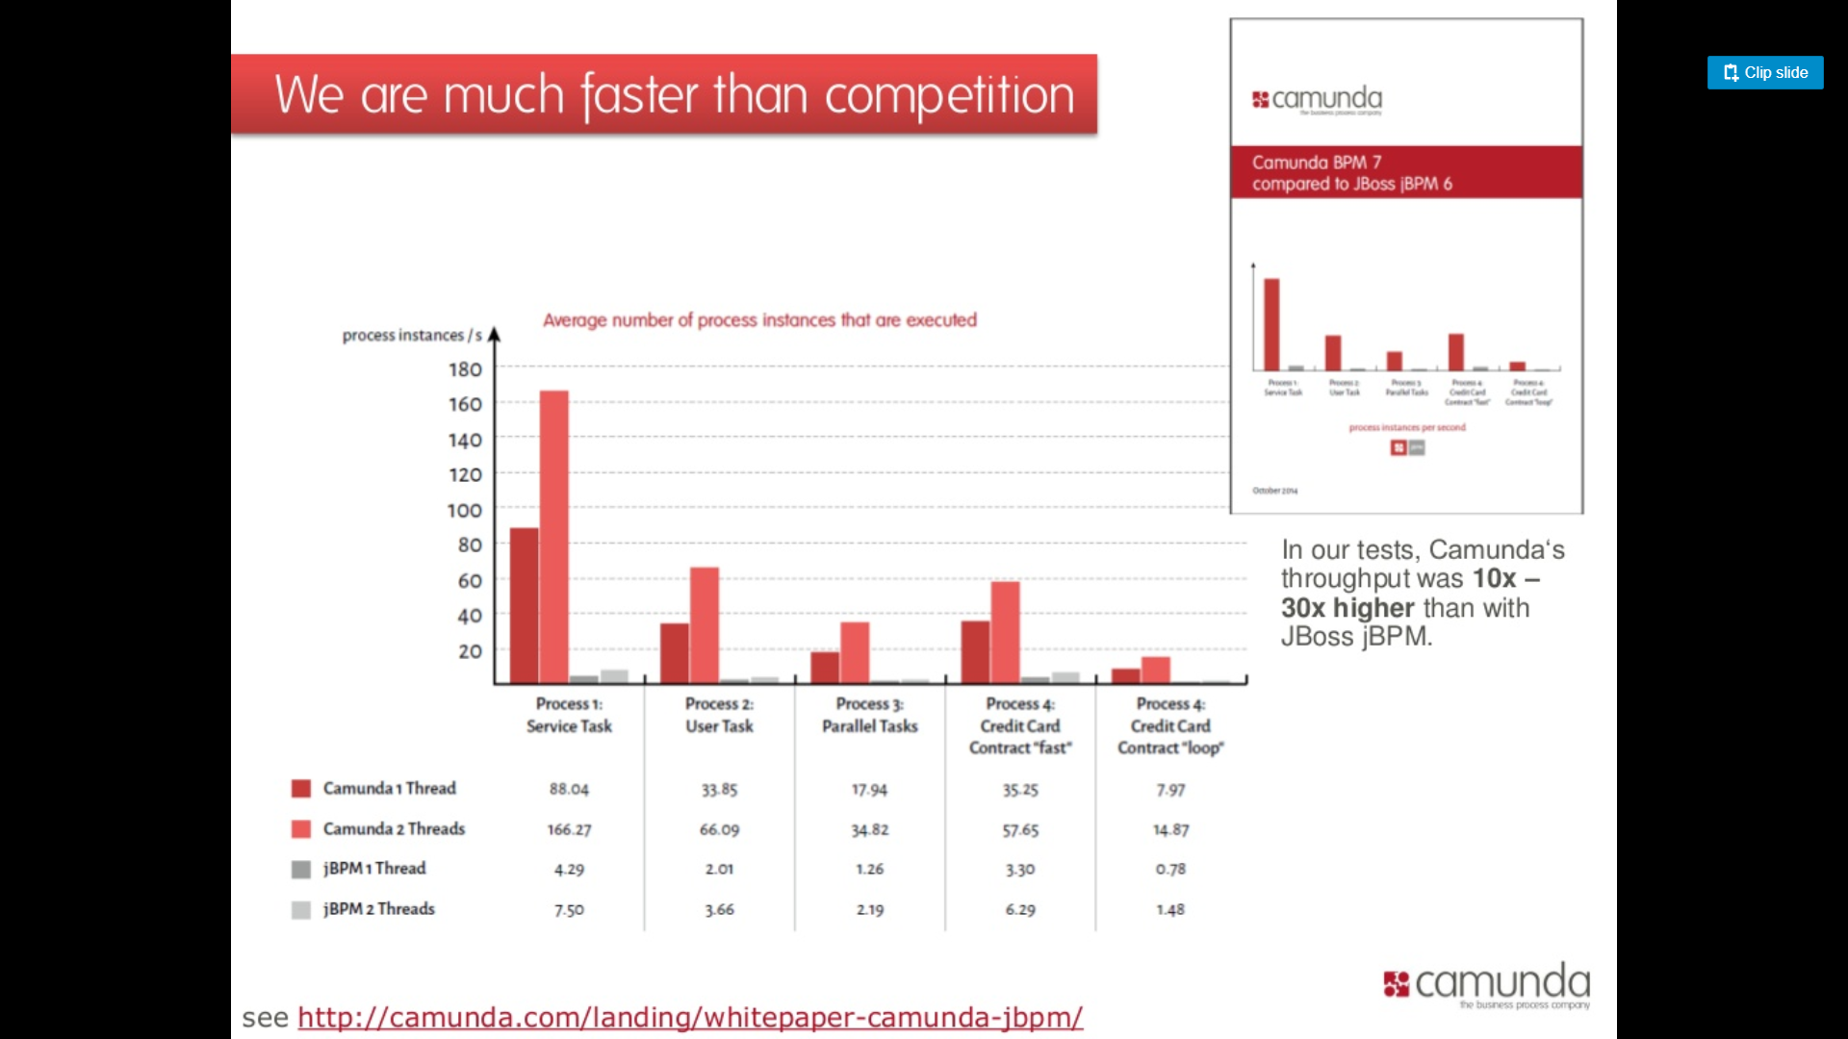

Slide 33
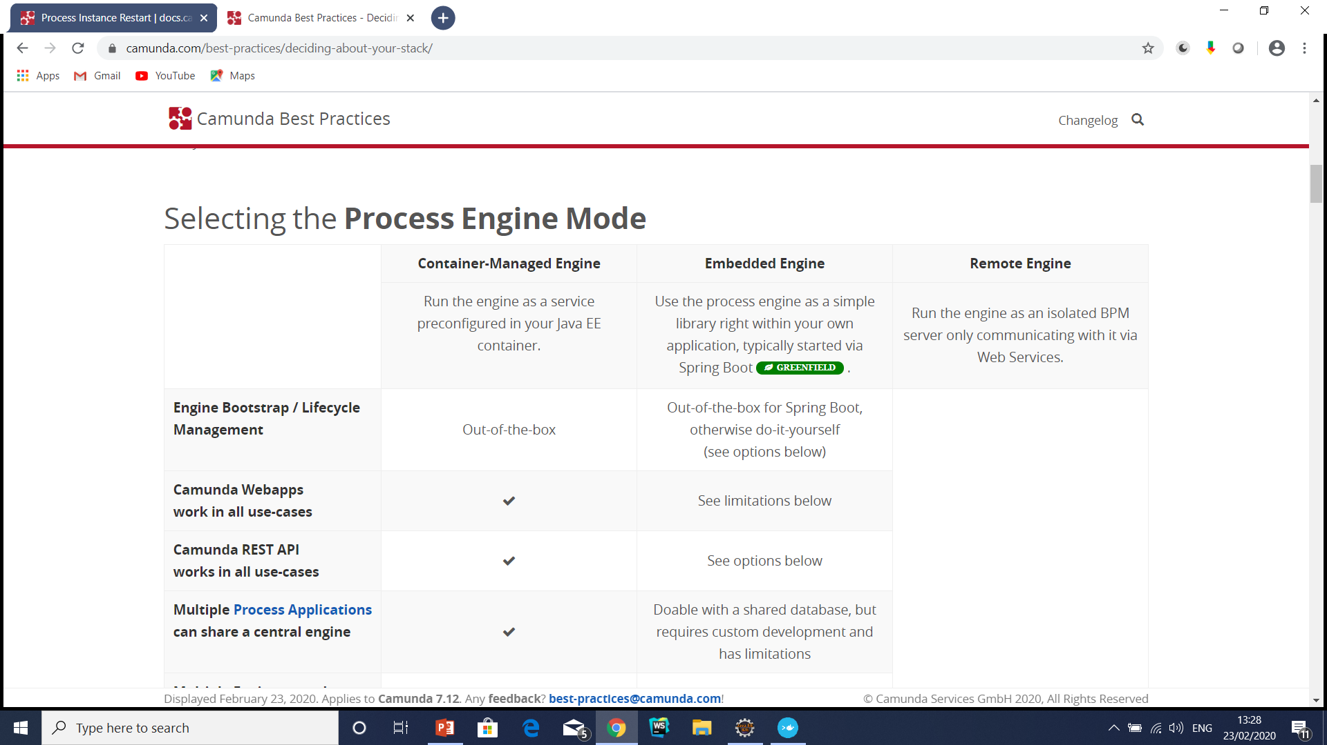
Selecting the Process Engine Mode

Slide 34
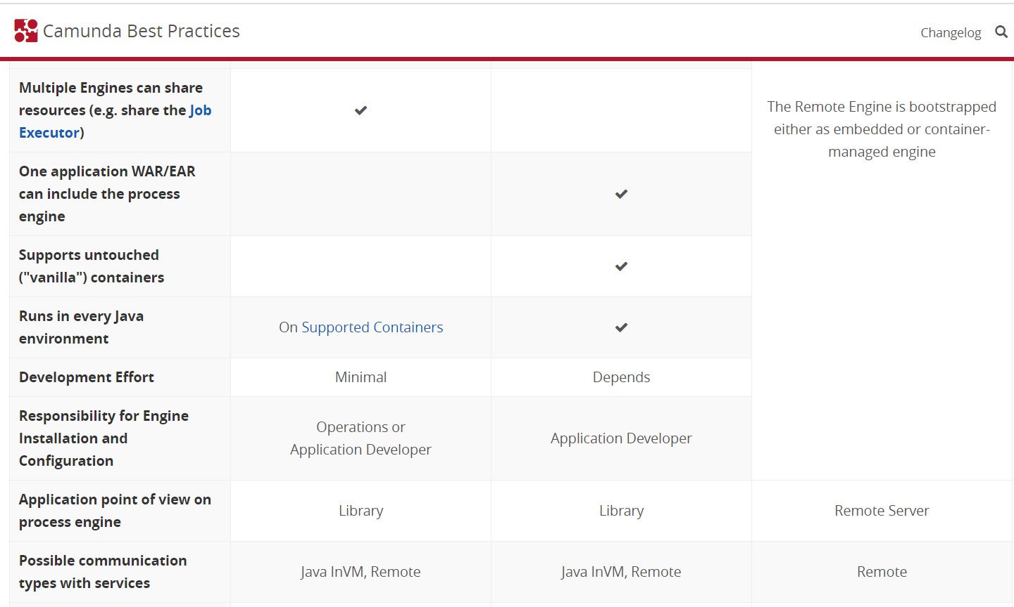
Selecting the Process Engine Mode

Slide 35
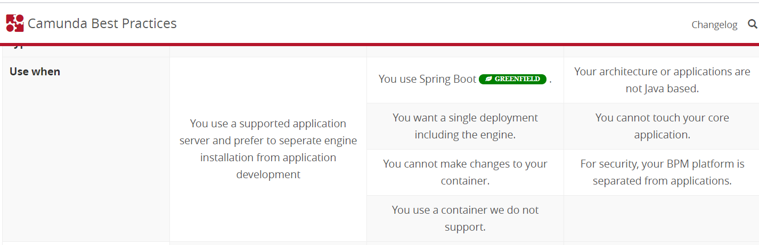
Selecting the Process Engine Mode

Slide 36
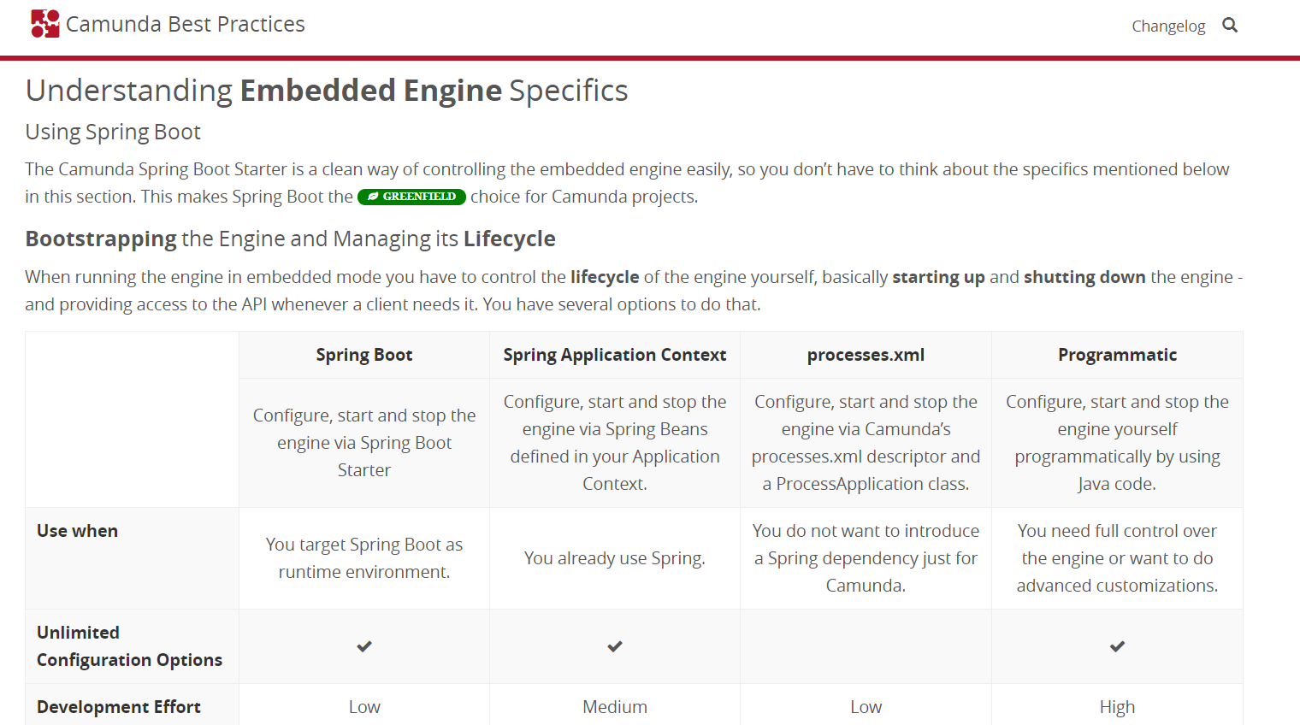

Slide 37
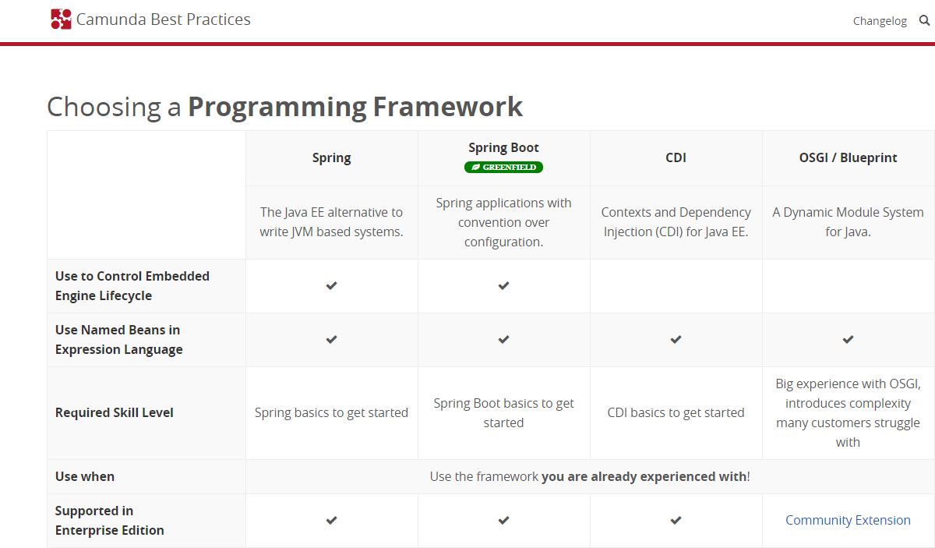

Slide 38
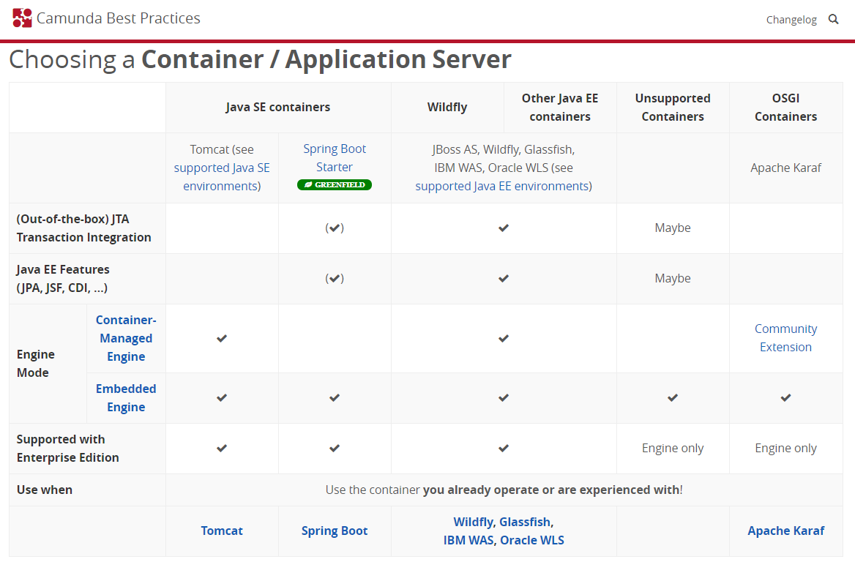

Slide 39
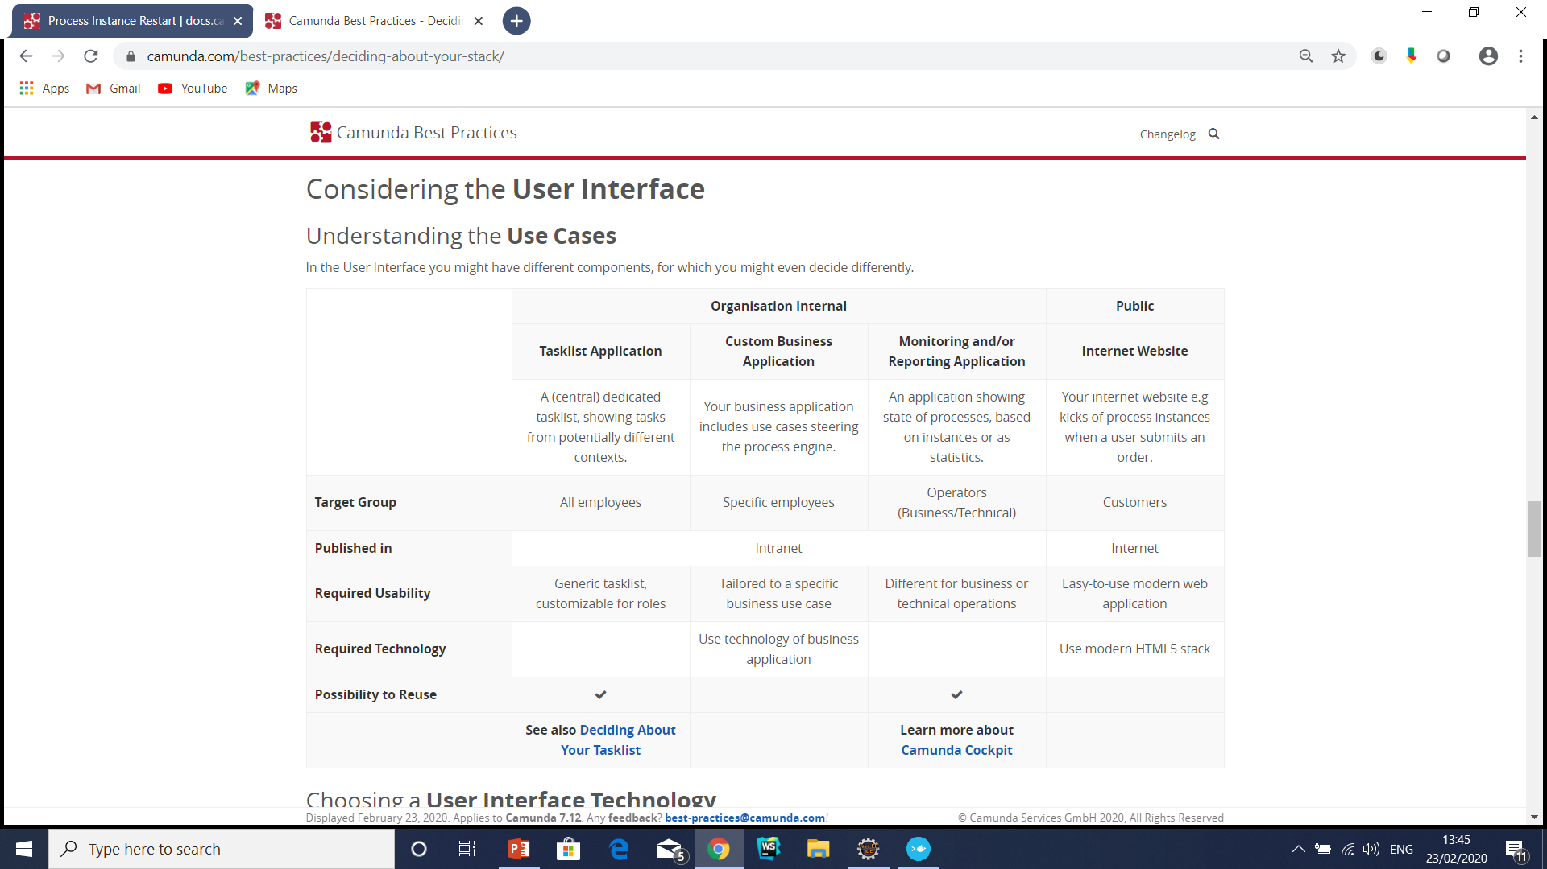

Slide 40
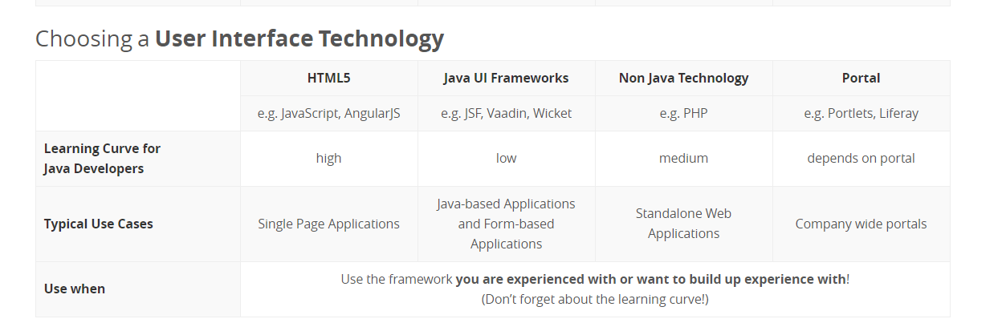

Slide 41
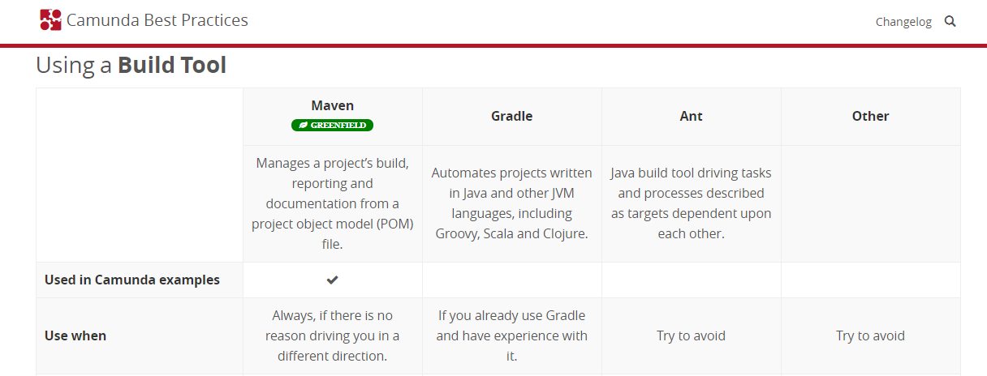

Slide 42
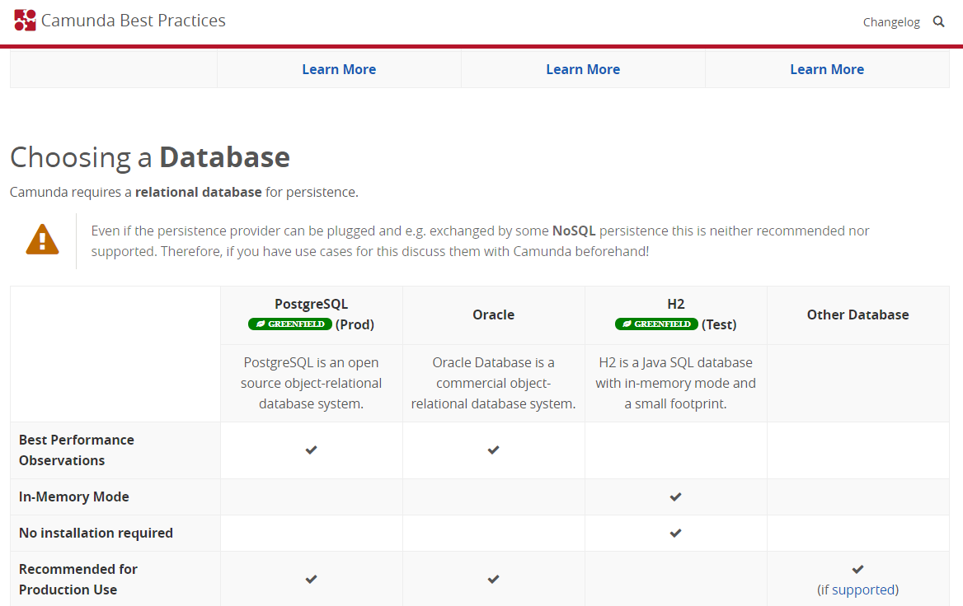

Slide 43
Web Application Architecture
The Camunda BPM web applications are based on a RESTful architecture.
Frameworks used:
JAX-RS based Rest API
AngularJS
RequireJS
jQuery
Twitter Bootstrap
camunda-bpmn.js
ngDefine
angular-data-depend

Slide 44
Container/Application Server for Runtime Components
Application-Embedded Process Engine
All Java application servers
Camunda Spring Boot Starter: Embedded Tomcat
Container-Managed Process Engine and Camunda Cockpit, Tasklist, Admin
Apache Tomcat 7.0 / 8.0 / 9.0
JBoss EAP 6.4 / 7.0 / 7.1 / 7.2
Wildfly Application Server 10.1 / 11.0 / 12.0 / 13.0 / 14.0 / 15.0 / 16.0 / 17.0 / 18.0
IBM WebSphere Application Server 8.5 / 9.0 (Enterprise Edition only)
Oracle WebLogic Server 12c (12R1,12R2) (Enterprise Edition only) and Deployment scenarios).

Slide 45
Container/Application Server for Runtime Components
Databases
Supported Database Products
MySQL 5.6 / 5.7
MariaDB 10.0 / 10.2 / 10.3
Oracle 11g / 12c / 18c
IBM DB2 10.5 / 11.1 (excluding IBM z/OS for all versions)
PostgreSQL 9.4 / 9.6 / 10.4 / 10.7 / 11.1 / 11.2
Amazon Aurora PostgreSQL compatible with PostgreSQL 9.6 / 10.4 / 10.7
Microsoft SQL Server 2012/2014/2016/2017
H2 1.4

Slide 46
Container/Application Server for Runtime Components
Web Browser
Google Chrome latest
Mozilla Firefox latest
Internet Explorer 11
Microsoft Edge
Java
Java 8 / 9 / 10 / 11 / 12 / 13 (if supported by your application server/container)

Slide 47
Container/Application Server for Runtime Components
Java Runtime
Oracle JDK 8 / 9 / 10 / 11 / 12 / 13
IBM JDK 8 (with J9 JVM)
OpenJDK 8 / 9 / 10 / 11 / 12 / 13, including builds of the following products:
Oracle OpenJDK
AdoptOpenJDK (with HotSpot JVM)
Amazon Corretto
Azul Zulu

Slide 48
Container/Application Server for Runtime Components
Camunda Modeler
Supported on the following platforms:
Windows 7 / 10
Mac OS X 10.11
Ubuntu LTS (latest)
Reported to work on
Ubuntu 12.04 and newer
Fedora 21
Debian 8

Slide 49
Container/Application Server for Runtime Components
List of Community Extensions
The following is a list of current (unsupported) community extensions:
Apache Camel Integration
Camunda Docker Images
Custom Batch
DMN Scala Extension
Elastic Search Extension
Email Connectors
FEEL Scala Extension
Grails Plugin

Slide 50
Container/Application Server for Runtime Components
GraphQL API
Keycloak Identity Provider Plugin
Migration API
Mockito Testing Library
Needle Testing Library
OSGi Integration
PHP SDK
Process Test Coverage
Reactor Event Bus
REST Client Spring Boot
Scenario Testing Library
Single Sign On for JBoss
Tasklist Translations
Wildfly Swarm

Slide 51
Container/Application Server for Runtime Components
Definition of Public API
The Camunda BPM public API is limited to the following items:
Java API:
All non-implementation Java packages (package name does not contain impl) of the following modules.
camunda-engine
camunda-engine-spring
camunda-engine-cdi
camunda-engine-dmn
camunda-bpmn-model

Slide 52
Container/Application Server for Runtime Components
camunda-cmmn-model
camunda-dmn-model
camunda-spin-core
camunda-connect-core
camunda-commons-typed-valuesSwarm

Slide 53
Bootstrap a Process Engine Using the Java API
ProcessEngineConfiguration.createStandaloneProcessEngineConfiguration();
ProcessEngineConfiguration.createStandaloneInMemProcessEngineConfiguration();
ProcessEngine processEngine = ProcessEngineConfiguration.createStandaloneInMemProcessEngineConfiguration() .setDatabaseSchemaUpdate(ProcessEngineConfiguration.DB_SCHEMA_UPDATE_FALSE)
.setJdbcUrl("jdbc:h2:mem:my-own-db;DB_CLOSE_DELAY=1000")
.setJobExecutorActivate("true")
.buildProcessEngine();

Slide 54
Configure Process Engine Using camunda cfg XML
<beans xmlns="http://www.springframework.org/schema/beans" xmlns:xsi="http://www.w3.org/2001/XMLSchema-instance" xsi:schemaLocation="http://www.springframework.org/schema/beans http://www.springframework.org/schema/beans/spring-beans.xsd">
<bean id="processEngineConfiguration" class="org.camunda.bpm.engine.impl.cfg.StandaloneProcessEngineConfiguration">
<property name="jdbcUrl" value="jdbc:h2:mem:camunda;DB_CLOSE_DELAY=1000" />
<property name="jdbcDriver" value="org.h2.Driver" />
<property name="jdbcUsername" value="sa" />
<property name="jdbcPassword" value="" />
<property name="databaseSchemaUpdate" value="true" />
<property name="jobExecutorActivate" value="false" />
<property name="mailServerHost" value="mail.my-corp.com" />
<property name="mailServerPort" value="5025" />
</bean></beans>

Slide 55
Configure Process Engine in the bpm-platform.xml
<?xml version="1.0" encoding="UTF-8"?>
<bpm-platform xmlns="http://www.camunda.org/schema/1.0/BpmPlatform"
xmlns:xsi="http://www.w3.org/2001/XMLSchema-instance"
xsi:schemaLocation="http://www.camunda.org/schema/1.0/BpmPlatform http://www.camunda.org/schema/1.0/BpmPlatform">
<job-executor>
<job-acquisition name="default" />
</job-executor>
<process-engine name="default">
<job-acquisition>default</job-acquisition>
<configuration>org.camunda.bpm.engine.impl.cfg.StandaloneProcessEngineConfiguration</configuration>
<datasource>java:jdbc/ProcessEngine</datasource>
<properties>
<property name="history">full</property>
<property name="databaseSchemaUpdate">true</property>
<property name="authorizationEnabled">true</property>
</properties>
</process-engine>
</bpm-platform>

Slide 56
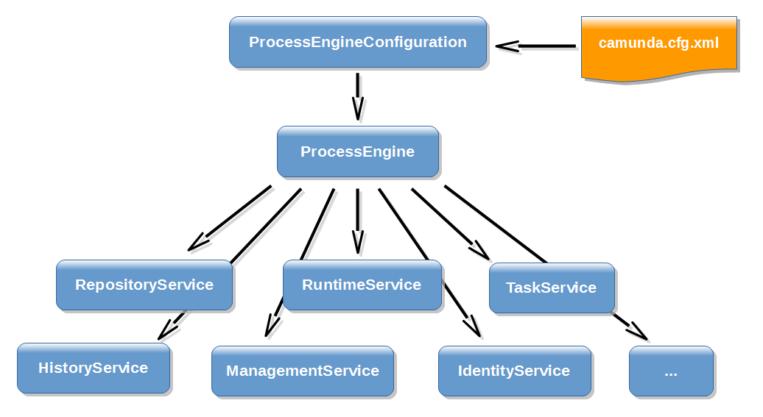
Process Engine API

Slide 57
Process Engine API
The RepositoryService is probably the first service needed when working with the Camunda engine.
This service offers operations for managing and manipulating deployments and process definitions.
RuntimeService is dynamic. It deals with starting new process instances of process definitions.
A process instance is one execution of such a process definition.
For each process definition there are typically many instances running at the same time.
The RuntimeService is also the service which is used to retrieve and store process variables.
This is data specific to the given process instance and can be used by various constructs in the process (e.g., an exclusive gateway often uses process variables to determine which path is chosen to continue the process).
The RuntimeService also allows to query on process instances and executions. Executions are a representation of the ‘token’ concept of BPMN 2.0.

Slide 58
Process Engine API
Tasks that need to be performed by actual human users of the system are core to the process engine.
Everything around tasks is grouped in the Task Service, such as
Querying tasks assigned to users or groups.
Creating new standalone tasks. These are tasks that are not related to a process instances.
Manipulating to which user a task is assigned or which users are in some way involved with the task.
Claiming and completing a task. Claiming means that someone decided to be the assignee for the task, meaning that this user will complete the task.

Slide 59
Process Engine API
The Identity Service is pretty simple.
It allows the management (creation, update, deletion, querying, …) of groups and users.
It is important to understand that the core engine actually doesn’t do any checking on users at runtime.
For example, a task could be assigned to any user, but the engine does not verify if that user is known to the system.
This is because the engine can also be used in conjunction with services such as LDAP, Active Directory, etc.

Slide 60
Process Engine API
The Form Service is an optional service.
This means that the Camunda engine can be used perfectly without it, without sacrificing any functionality.
This service introduces the concept of a start form and a task form.
A start form is a form that is shown to the user before the process instance is started, while a task form is the form that is displayed when a user wants to complete a form.

Slide 61
Process Engine API
The HistoryService exposes all historical data gathered by the engine.
When executing processes, a lot of data can be kept by the engine (this is configurable) such as process instance start times, who did which tasks, how long it took to complete the tasks, which path was followed in each process instance, etc.
This service exposes mainly query capabilities to access this data.

Slide 62
Process Engine API
The Management Service is typically not needed when coding custom applications.
It allows to retrieve information about the database tables and table metadata.
Furthermore, it exposes query capabilities and management operations for jobs.
Jobs are used in the engine for various things such as timers, asynchronous continuations, delayed suspension/activation, etc.

Slide 63
Process Engine API
The Filter Service allows to create and manage filters.
Filters are stored queries like task queries.
For example filters are used by Tasklist to filter user tasks.
The External TaskService provides access to external task instances.
External tasks represent work items that are processed externally and independently of the process engine.

Slide 64
Process Engine API
The Case Service is like the RuntimeService but for case instances.
It deals with starting new case instances of case definitions and managing the lifecycle of case executions.
The service is also used to retrieve and update process variables of case instances.
The Decision Service allows to evaluate decisions that are deployed to the engine.
It is an alternative to evaluate a decision within a business rule task that is independent from a process definition.

Slide 65
Process Engine API
ProcessEngine processEngine = ProcessEngines.getDefaultProcessEngine();
RepositoryService repositoryService = processEngine.getRepositoryService();
RuntimeService runtimeService = processEngine.getRuntimeService();
TaskService taskService = processEngine.getTaskService();
IdentityService identityService = processEngine.getIdentityService();
FormService formService = processEngine.getFormService();
HistoryService historyService = processEngine.getHistoryService();
ManagementService managementService = processEngine.getManagementService();
FilterService filterService = processEngine.getFilterService();
ExternalTaskService externalTaskService = processEngine.getExternalTaskService();
CaseService caseService = processEngine.getCaseService();
DecisionService decisionService = processEngine.getDecisionService();

Slide 66
Process Variables
Variables can be used to add data to process runtime state or, more particular, variable scopes.
Various API methods that change the state of these entities allow updating of the attached variables.
In general, a variable consists of a name and a value.
The name is used for identification across process constructs.
For example, if one activity sets a variable named var, a follow-up activity can access it by using this name.
The value of a variable is a Java object.

Slide 67
Variable Scopes and Variable Visibility
In general, variables are accessible in the following cases:
Instantiating processes
Delivering messages
Task lifecycle transitions, such as completion or resolution
Setting/getting variables from outside
Setting/getting variables in a Delegate
Expressions in the process model
Scripts in the process model
(Historic) Variable queries

Slide 68
Variable Scopes and Variable Visibility
// Java Object API: Get Variable
Integer val1 = (Integer) execution.getVariable("val1");
// Typed Value API: Get Variable
IntegerValue typedVal2 = execution.getVariableTyped("val2");
Integer val2 = typedVal2.getValue();
Integer diff = val1 - val2;
// Java Object API: Set Variable
execution.setVariable("diff", diff);
// Typed Value API: Set Variable
IntegerValue typedDiff = Variables.integerValue(diff);
execution.setVariable("diff", typedDiff);

Slide 69
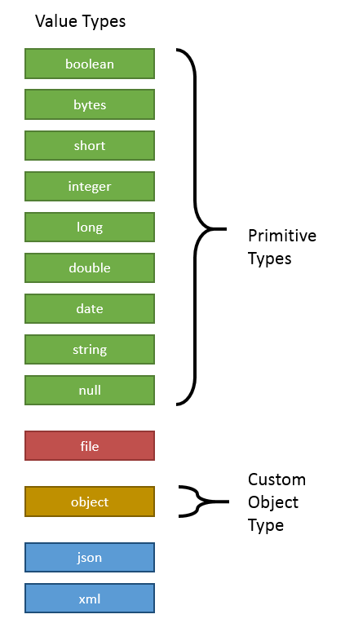
Supported Variable Values

Slide 70
Delegation Code
Delegation Code allows you to execute external Java code, evaluate expressions or scripts when certain events occur during process execution.
There are different types of Delegation Code:
Java Delegates can be attached to a BPMN ServiceTask.
Execution Listeners can be attached to any event within the normal token flow, e.g. starting a process instance or entering an activity.
Task Listeners can be attached to events within the user task lifecycle, e.g. creation or completion of a user task.

Slide 71
Java Delegate
public class ToUppercase implements JavaDelegate {
public void execute(DelegateExecution execution) throws Exception {
String var = (String) execution.getVariable("input");
var = var.toUpperCase();
execution.setVariable("input", var);
}
}

Slide 72
Multi-Tenancy
Multi-Tenancy regards the case in which a single Camunda installation should serve more than one tenant.
For each tenant, certain guarantees of isolation should be made.
For example, one tenant’s process instances should not interfere with those of another tenant.

Slide 73
Multi-Tenancy
Multi-Tenancy can be achieved in two different ways.
One way is to use one process engine per tenant.
The other way is to use just one process engine and associate the data with tenant identifiers.
The two ways differ from each other in the level of data isolation, the effort of maintenance and the scalability.
A combination of both ways is also possible.

Slide 74
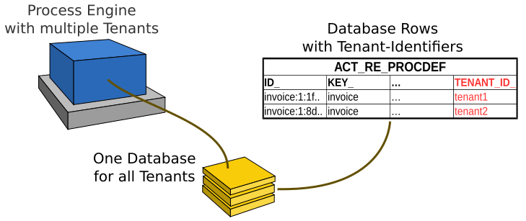
Single Process Engine With Tenant-Identifiers

Slide 75
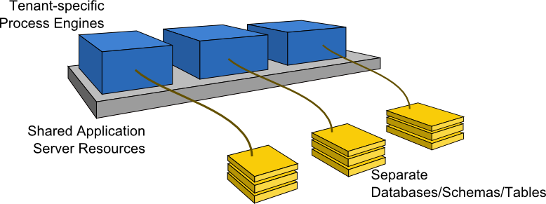
One Process Engine Per Tenant

Slide 76
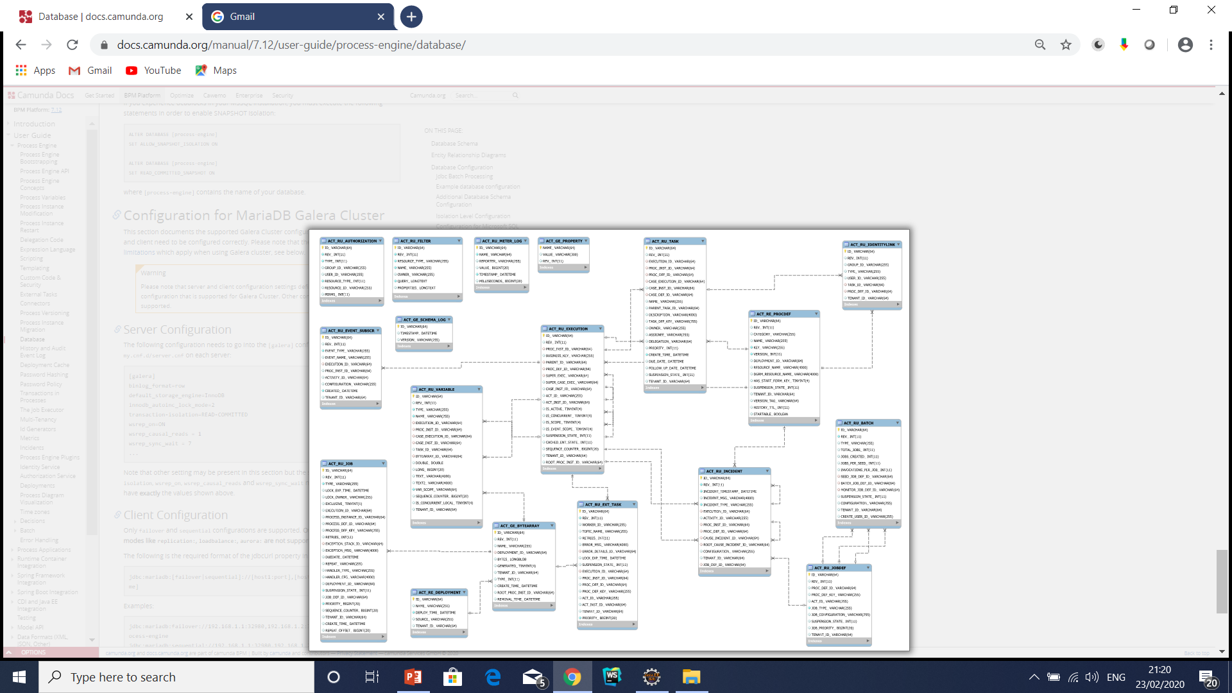

Slide 77
BPMN
Business Process Model and Notation (BPMN) is a standard for Workflow and Process Automation. Camunda supports the 2.0 version of BPMN.

Slide 78
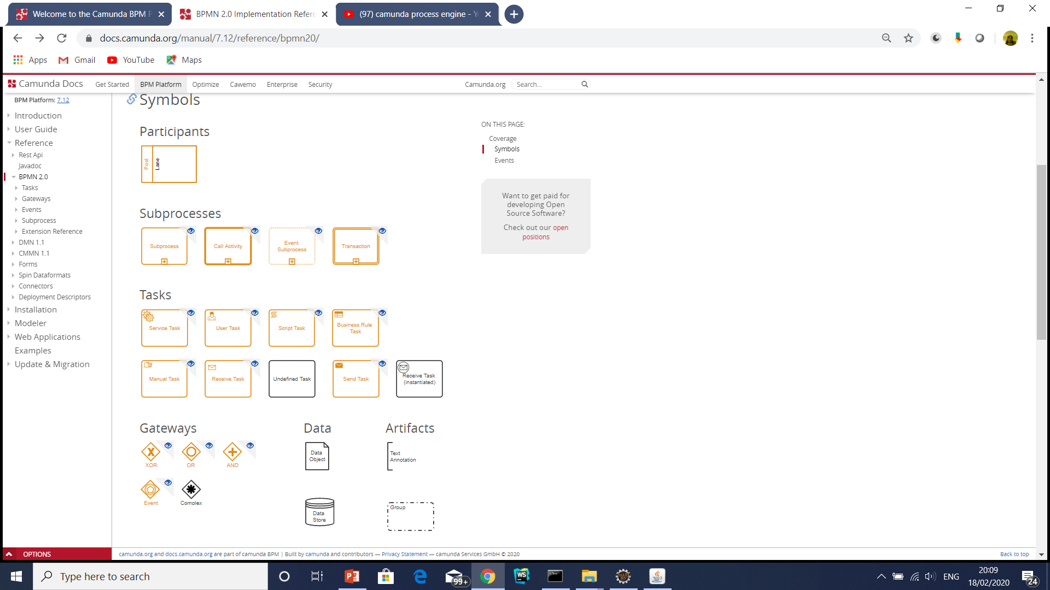
Symbols

Slide 79
Events
Start events define where a Process or Sub Process starts.
The process engine supports different types of start events:
Blank
Timer
Message
Signal
Conditional

Slide 80
None Events (Blank)
None events are unspecified events, also called ‘blank’ events.
For instance, a ‘none’ start event technically means that the trigger for starting the process instance is unspecified.
This means that the engine cannot anticipate when the process instance must be started.
The none start event is used when the process instance is started through the API by calling one of the startProcessInstanceBy... methods.
ProcessInstance processInstance = runtimeService.startProcessInstanceByKey('invoice');

Slide 81
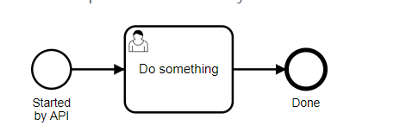
None Events (Blank)

Slide 82
None End Event
A ‘none’ end event means that the result thrown when the event is reached is unspecified.
As such, the engine will not do anything besides ending the current path of execution.
The XML representation of a none end event is the normal end event declaration, without any sub-element (other end event types all have a sub-element declaring the type).
<endEvent id="end" name="my end event" />

Slide 83
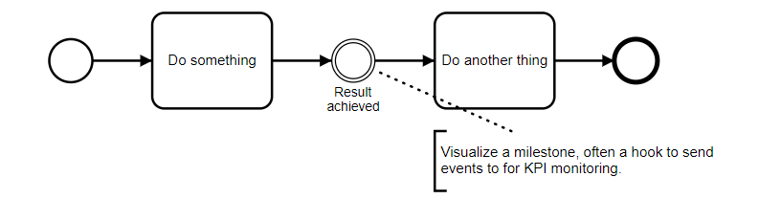
Intermediate None Event (throwing)
The following process diagram shows a simple example of an intermediate none event, which is often used to indicate some state achieved in the process.
<intermediateThrowEvent id="noneEvent">
<extensionElements>
<camunda:executionListener class="org.camunda.bpm.engine.test.bpmn.event.IntermediateNoneEventTest$MyExecutionListener" event="start" />
</extensionElements>
</intermediateThrowEvent>

Slide 84

Timer Events
Timer events are events which are triggered by a defined timer.
They can be used as start event, intermediate event or boundary event. Boundary events can be interrupting or not.

Slide 85
Defining a Timer
<timerEventDefinition>
<timeDate>2011-03-11T12:13:14Z</timeDate>
</timerEventDefinition>

Slide 86
Time Duration
To specify how long the timer should run before it is fired, a timeDuration can be specified as a sub-element of timerEventDefinition.
It is possible to define the duration in two different ISO 8601 Durations formats:
PnYnMnDTnHnMnS
PnW
<timerEventDefinition>
<timeDuration>P10D</timeDuration>
</timerEventDefinition>

Slide 87
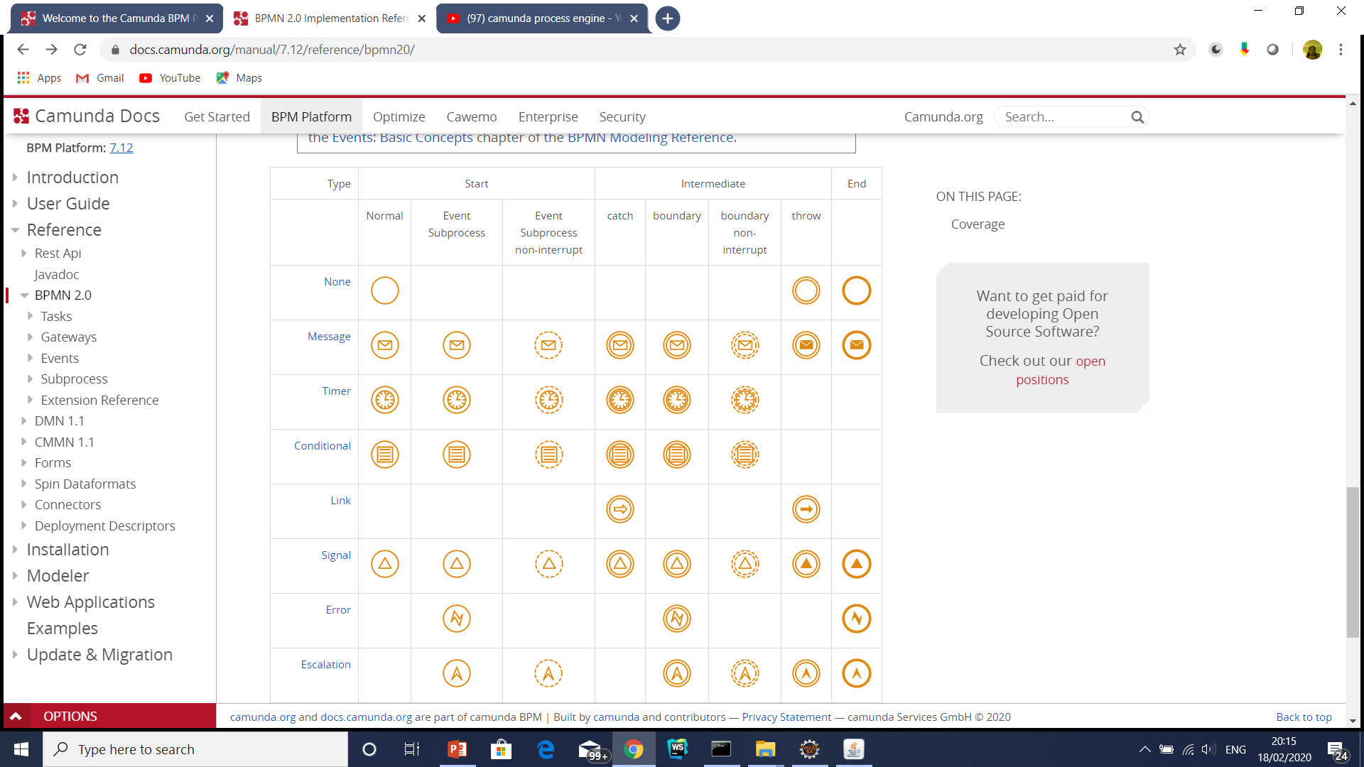
Events

Slide 88
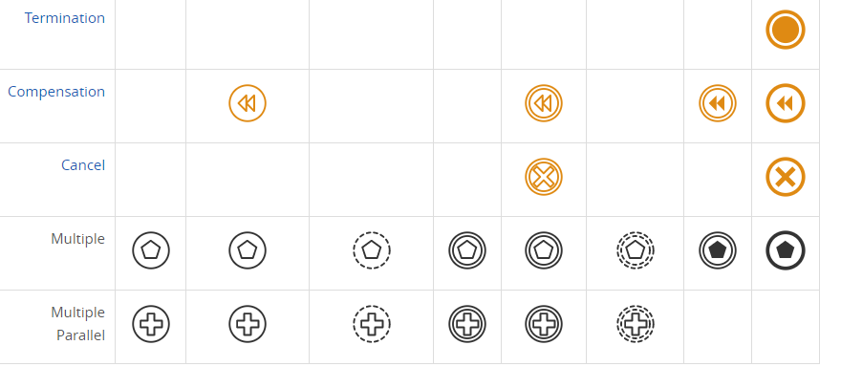
Events

Slide 89
Tasks
Service Task
Invoke or execute business logic.
Send Task
Send a message.
User Task
A task performed by a human participant.
Business Rule Task
Execute an automated business decision.
Script Task
Execute a Script.
Receive Task
Wait for a message to arrive.
Manual Task
A task which is performed externally.
Task Markers
Markers control operational aspects like repetition.

Slide 90
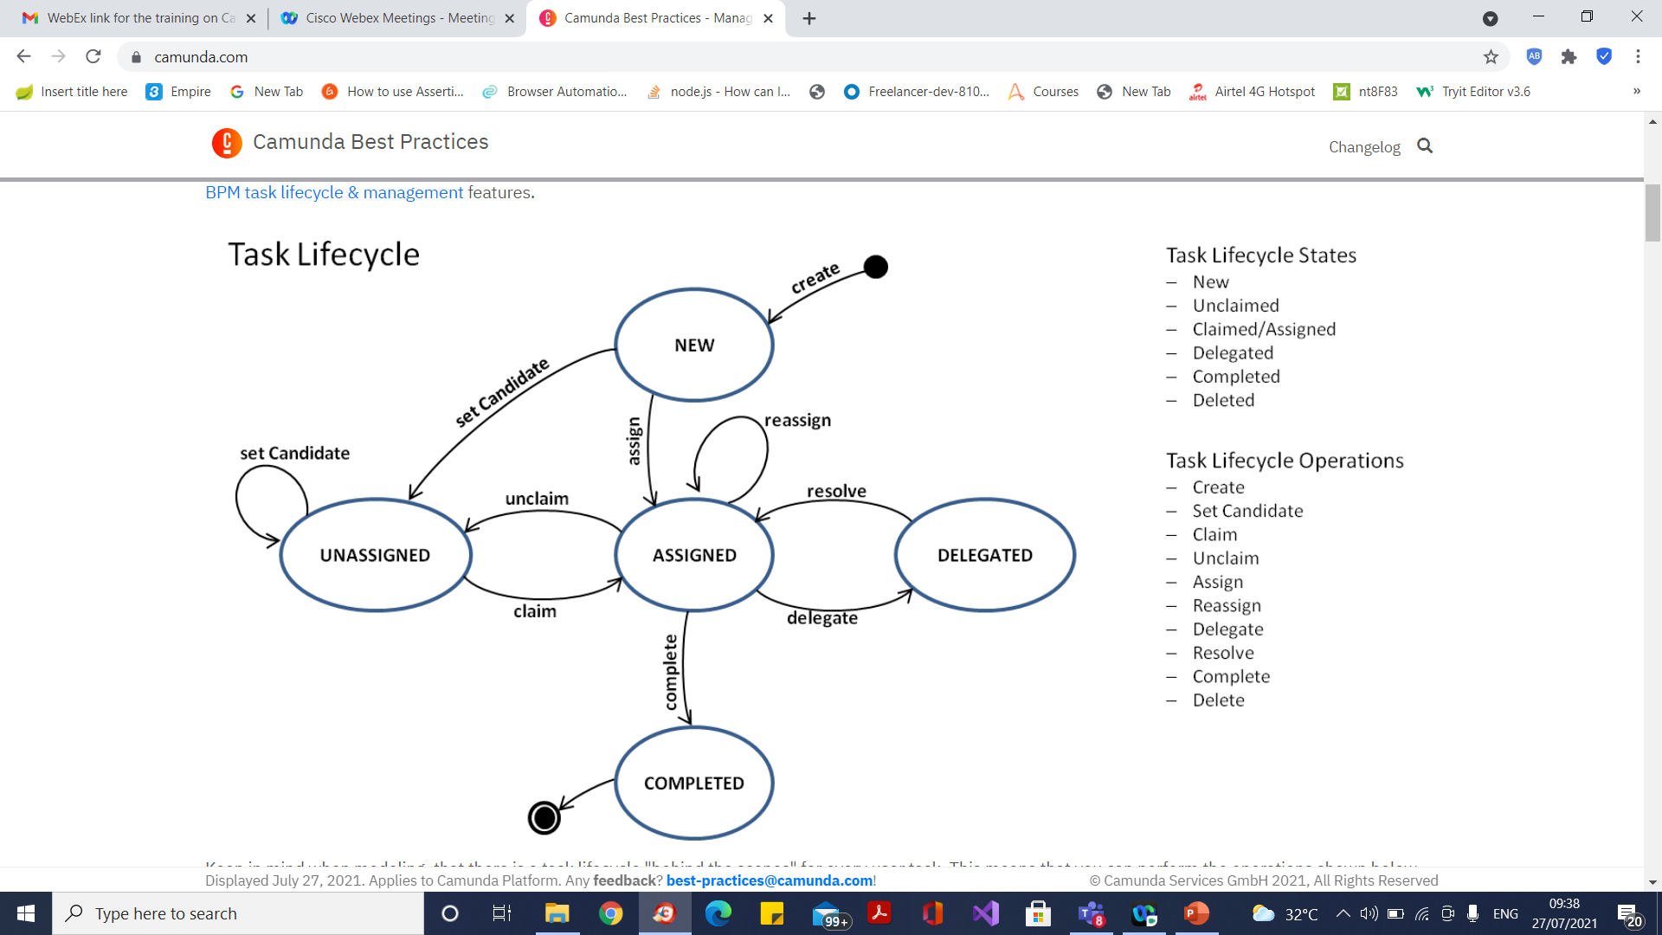
Task Lifecycle

Slide 91
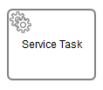
Service Task
A Service Task is used to invoke services.
In Camunda this is done by calling Java code or providing a work item for an external worker to complete asynchronously.

Slide 92
Service Task
Calling Java Code
There are four ways of declaring how to invoke Java logic:
Specifying a class that implements a Java Delegate or Activity Behavior
Evaluating an expression that resolves to a delegation object
Invoking a method expression
Evaluating a value expression

Slide 93
Service Task
<serviceTask id="javaService"
name="My Java Service Task" camunda:class="org.camunda.bpm.MyJavaDelegate" />
<serviceTask id="beanService"
name="My Bean Service Task" camunda:delegateExpression="${myDelegateBean}" />
<serviceTask id="expressionService"
name="My Expression Service Task"
camunda:expression="${myBean.doWork()}" />

Slide 94
Service Task Results
<serviceTask id="aMethodExpressionServiceTask" camunda:expression="#{myService.doSomething()}" camunda:resultVariable="myVar" />

Slide 95
External Tasks
When a Service Task is declared external, the process engine offers a work item to workers that independently poll the engine for work to do.
This decouples the implementation of tasks from the process engine and allows to cross system and technology boundaries.
Calling Java code, where the process engine synchronously invokes Java logic, External Task contrast to this.

Slide 96
External Tasks
<serviceTask id="anExternalServiceTask"
camunda:type="external"
camunda:topic="ShipmentProcessing" />

Slide 97
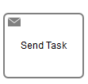
Send Task
A Send Task is used to send a message. In Camunda this is done by calling Java code.
The Send Task has the same behavior as a Service Task.
<sendTask id="sendTask" camunda:class="org.camunda.bpm.MySendTaskDelegate" />

Slide 98
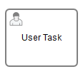
User Task
A User Task is used to model work that needs to be done by a human actor.
When the process execution arrives at such a User Task, a new task is created in the task list of the user(s) or group(s) assigned to that task.
<userTask id="theTask" name="Important task" />

Slide 99
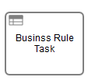
Business Rule Task
A Business Rule Task is used to synchronously execute one or more rules.
<businessRuleTask id="businessRuleTask"
camunda:decisionRef="myDecision"
camunda:decisionRefBinding="version"
camunda:decisionRefVersion="12" />

Slide 100
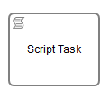
Script Task
A Script Task is an automated activity. When a process execution arrives at the Script Task, the corresponding script is executed.
<scriptTask id="theScriptTask" name="Execute script" scriptFormat="groovy">
<script>
sum = 0
for ( i in inputArray ) {
sum += i
}
</script>
</scriptTask>

Slide 101
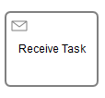
Receive Task
A Receive Task is a simple task that waits for the arrival of a certain message.
When the process execution arrives at a Receive Task, the process state is committed to the persistence storage.
This means that the process will stay in this wait state until a specific message is received by the engine, which triggers continuation of the process beyond the Receive Task.

Slide 102
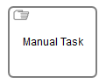
Manual Task
A Manual Task defines a task that is external to the BPM engine.
It is used to model work that is done by somebody who the engine does not need to know of and is there no known system or UI interface.
For the engine, a manual task is handled as a pass-through activity, automatically continuing the process at the moment the process execution arrives at it.
<manualTask id="myManualTask" name="Manual Task" />

Slide 103
Gateways
Data-based Exclusive Gateway (XOR)
Model decisions based on data.
Conditional and Default Sequence Flows
Concurrency and decisions without Gateways.
Parallel Gateway
Model fork / join concurrency.
Inclusive Gateway
Model conditional fork / join concurrency.
Event-based Gateway
Model decisions based on events.

Slide 104
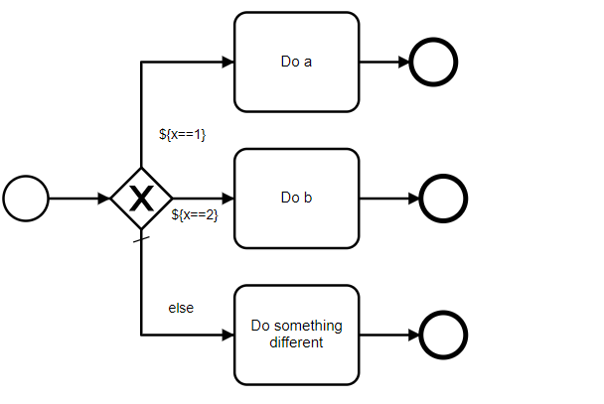
Conditional and Default Sequence Flows

Slide 105
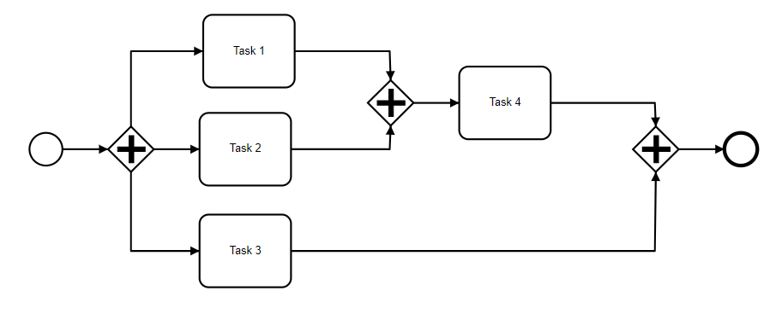
Parallel Gateway

Slide 106
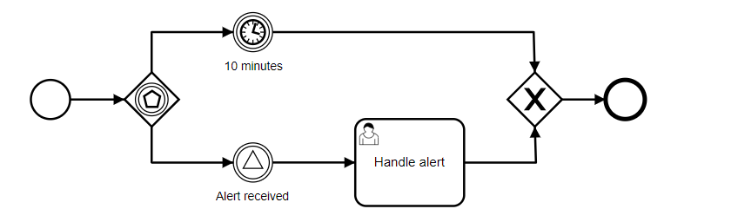
Event-based Gateway

Slide 107

Call Activity

Slide 108
Spring Boot Query History
http://localhost:7070/rest/history/process-instance
http://localhost:7070/rest/history/process-instance?finishedAfter=2013-01-01T00:00:00.000+0200&finishedBefore=2013-04-01T23:59:59.000+0200&executedActivityAfter=2013-03-23T13:42:44.000+0200

Slide 109
DMN
Decision Model and Notation (DMN) is a standard for Business Decision Management.
Currently the Camunda DMN engine partially supports DMN 1.1, including Decision Tables, Decision Literal Expressions, Decision Requirements Graphs and the Friendly Enough Expression Language (FEEL).

Slide 110


Slide 111


Slide 112
Visual representation | XML representation
U | UNIQUE
A | ANY
F | FIRST
R | RULE ORDER
C | COLLECT

Slide 113


Slide 114


Slide 115


Slide 116


Slide 117


Slide 118


Slide 119


Slide 120


Slide 121


Slide 122


Slide 123


Slide 124


Slide 125
Friendly Enough Expression Language (FEEL)
Decision Model and Notation (DMN) defines a Friendly Enough Expression Language (FEEL).
It can be used to evaluate expressions in a decision table.
The Camunda DMN engine only supports FEEL for input entries of a decision table.
This corresponds to FEEL simple unary tests.

Slide 126

Friendly Enough Expression Language (FEEL)

Slide 127

Friendly Enough Expression Language (FEEL)

Slide 128

FEEL Language Elements

Slide 129

FEEL Language Elements

Slide 130

FEEL Language Elements

Slide 131

FEEL Language Elements

Slide 132

FEEL Language Elements

Slide 133
Camunda BPM Platform Docker Images
docker pull camunda/camunda-bpm-platform:latest
docker run -d --name camunda -p 8080:8080 camunda/camunda-bpm-platform:latest
# open browser with url: http://192.168.99.101:8080/camunda-welcome/index.html

Slide 134

Business Transaction

Slide 135

Transaction

Slide 136

Transaction Boundaries

Slide 137

Why Asynchronous Continuations?

Slide 138

Rollback on Exception

Slide 139

Async Demo

Slide 140

Async Demo

Slide 141

Async Demo

Slide 142

Task Marker

Slide 143

Dealing With Problems and Exceptions

Slide 144

Dealing With Problems and Exceptions

Slide 145

Dealing With Problems and Exceptions

Slide 146

Dealing With Problems and Exceptions

Slide 147

Camunda Rest Message

Slide 148

Send Message

Slide 149

Send Message

Slide 150

Send Message

Slide 151

Send Message

Slide 152

Security

Slide 153
Questions

